Slide 1
Boston Housing - Linear Regression
Anurag Wankhade

Slide 2
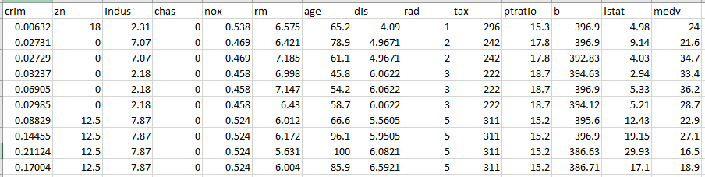
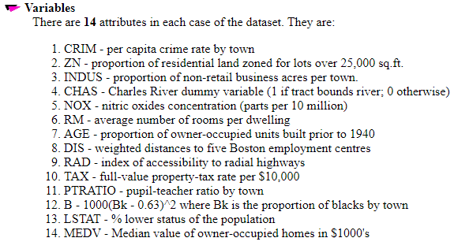
Problem Statement
Create a linear regression model to predict “medv”
(median values of home) based on given variables
Sample Input data
Total: 506 rows

Slide 3
Steps
Create spark context. Read data from csv to create RDD & remove header.
Create dataframe from RDD.
Defining functions for feature addition based on one & multiple columns. Create UDF to apply function to dataframe columns.
Convert features to vectors. Split dataframe in training & test set.
Create linear regression model & fit to training data.
Predict for test data & evaluate accuracy (RMSE) for the model
Feature engineering
Feature giving extreme high nitric oxide concentration for housings. Housings with more than 0.6 nitric oxide concentration are identified as 1 & housings with less than 0.6 are identified as 0.
Accessibility for economic activity like distance from employment center & radial highway. Housings with less than 3.8 weighted distance from employment center as well as less than 9.5 index of accessibility from radial highway are deemed as less accessible for economic activity and assigned value of 1. Remaining housing are assigned value 0.

Slide 4
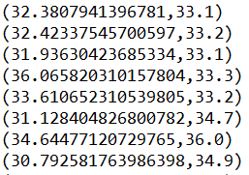
Result
Sample prediction & true value for ‘medv’
Linear regression model has RMSE accuracy score of about 4.7
Conclusion
More relevant feature addition gives better accuracy.
Parameters for linear regression model can be modified to improve the accuracy.
Large amount of data can be processed parallelly using the model.

